Slide 1

Animation
Emerging Technology : Flutter
Week 7
Program Studi Teknik Informatika
Fakultas Teknik – Universitas Surabaya

Slide 2

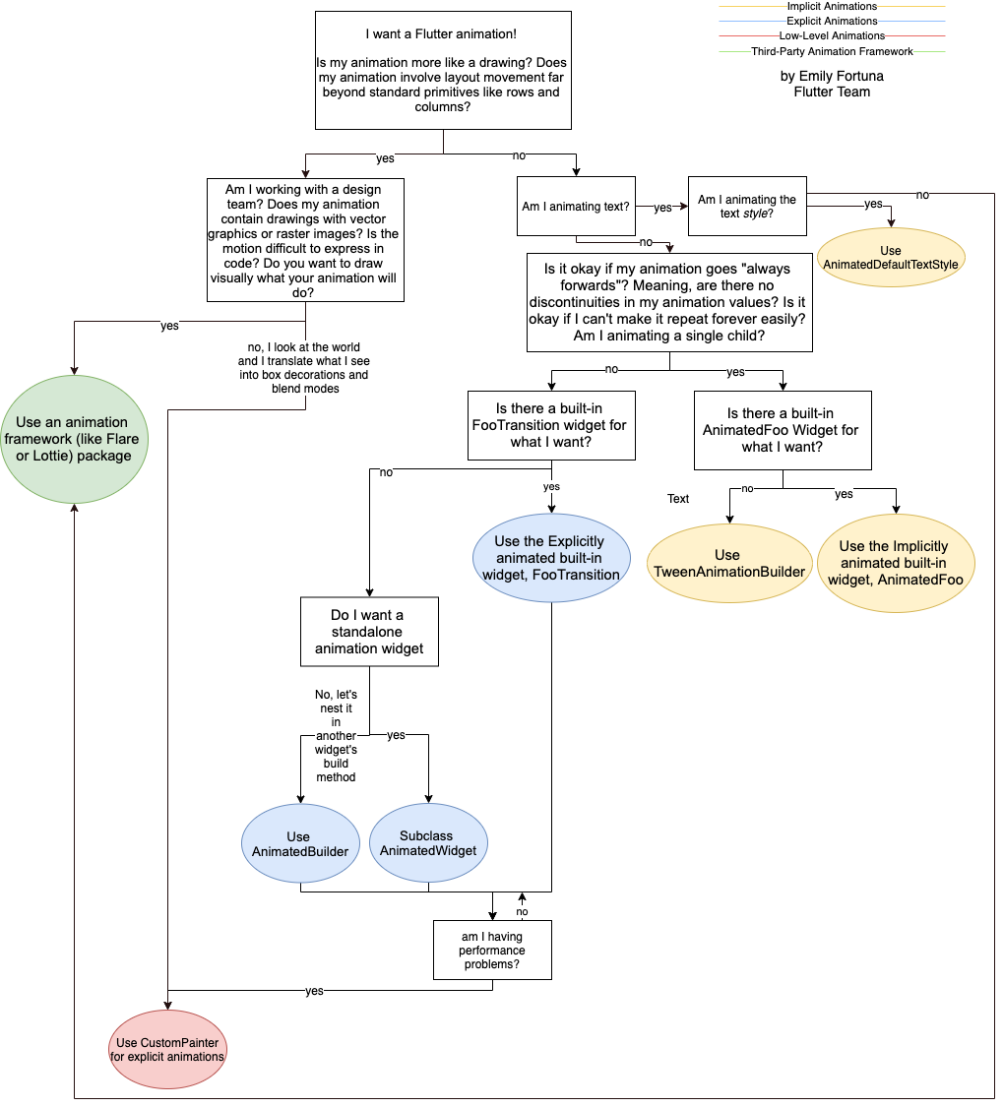
Define your need
https://flutter.dev/docs/development/ui/animations

Slide 3

IMPLICIT ANIMATION
01

Slide 4
Implicit animation
The most straightforward way to add animations to your app. You don’t have to be an expert on animations or animation terminology to add animations to your app.
AnimatedDefaultTextStyle, which is an implicitly animated version of DefaultTextStyle. V
AnimatedAlign, which is an implicitly animated version of Align. V
AnimatedOpacity, which is an implicitly animated version of Opacity. V
AnimatedPadding, which is an implicitly animated version of Padding.
AnimatedPhysicalModel, which is an implicitly animated version of PhysicalModel.
AnimatedContainer, which is an implicitly animated version of Container. V
AnimatedPositioned, which is an implicitly animated version of Positioned.
AnimatedPositionedDirectional, which is an implicitly animated version of PositionedDirectional.
AnimatedSwitcher, which fades from one widget to another. V
AnimatedTheme, which is an implicitly animated version of Theme.
AnimatedCrossFade, which cross-fades between two given children and animates itself between their sizes. V
AnimatedSize, which automatically transitions its size over a given duration.
TweenAnimationBuilder, which animates any property expressed by a Tween to a specified target value. V

Slide 5
Page Preparation
In order to try some animation widget, we will use a new stateful widget with the root widget is a SingleChildScrollView
with Column so it can contain a lot of widget without worrying exceeding the screen height. Prepare also the menu to open this screen.
import 'package:flutter/material.dart';
class Animasi extends StatefulWidget {
const Animasi({super.key});
@override
State<Animasi> createState() => _AnimasiState();
}
class _AnimasiState extends State<Animasi> {
@override
Widget build(BuildContext context) {
return Scaffold(
appBar: AppBar(
title: const Text('animation test'),
),
body: SingleChildScrollView(child: Column(children: <Widget>[
])));
}
}

Slide 6
ANIMATEDDEFAULTTEXTSTYLE
02

Slide 7
AnimatedDefaultTextStyle
AnimatedDefaultTextStyle requires 3 mandatory parameters :
duration : The duration or the time period over which you want your animation to complete.
child : The child widget which you want to pass to your AnimatedDefaultTextStyle.
style : The TextStyle which you want to apply for your Text
The child doesn’t necessarily have to be a Text widget. The way it works is that it accepts any widget and it then applies the style which we’ve passed to all the descendants which are Text in that tree.
For example, you could pass your child a Row which has 3 Text children, so AnimatedDefaultTextStyle will apply the style to all the 3 Text widgets.

Slide 8
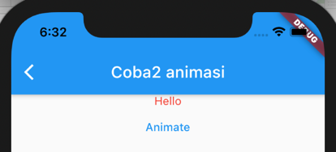
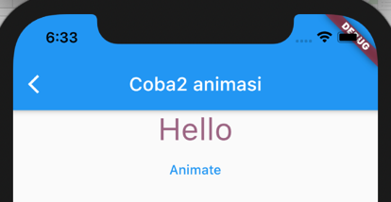
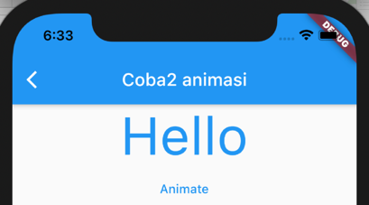
Animating Text
We will add a text and a button. When user clicks the button, the text is animated by changing its style.
AnimatedDefaultTextStyle(
style: _animated
? const TextStyle(
color: Colors.blue,
fontSize: 60,
)
: const TextStyle(
color: Colors.red,
fontSize: 14,
),
duration: const Duration(milliseconds: 1000),
child: const Center(child: Text('Hello')),
),
TextButton(
child: const Text('Animate'),
onPressed: () {
setState(() {
_animated = !_animated;
});
},
)

Slide 9
Adding timer
Text Animation in previous slide can be raised anytime using another events, by changing the value of the Boolean variable animated. Therefore a timer also can be used to raise the animation.
late Timer _timer;
@override
void initState() {
super.initState();
_timer = Timer.periodic(Duration(milliseconds: 3000), (timer) {
setState(() {
_animated = !_animated;
});
});
}

Slide 10
ANIMATEDALIGN
03

Slide 11
AnimatedAlign
Animated version of Align which automatically transitions the child's position over a given duration whenever the given alignment changes.
SizedBox(
width: 250.0,
height: 250.0,
child: AnimatedAlign(
alignment: _animated ? Alignment.topRight : Alignment.bottomLeft,
duration: const Duration(seconds: 3),
curve: Curves.fastOutSlowIn,
child: ClipOval(
child: Image.network(
'https://i.pravatar.cc/100',
width: 100,
height: 100,
fit: BoxFit.cover,
),
),
))
https://api.flutter.dev/flutter/animation/Curves-class.html

Slide 12
ANIMATED
OPACITY
04

Slide 13
AnimatedOpacity
Animated version of Opacity which automatically transitions the child's opacity over a given duration whenever the given opacity changes.
SizedBox(
width: 250.0,
height: 250.0,
child: AnimatedOpacity(
opacity: _opacityLevel,
duration: const Duration(seconds: 5),
child:
Image.network('https://i.pravatar.cc/240?img=6'),
))
_timer2 = Timer.periodic(Duration(milliseconds: 5000), (timer) {
setState(() {
_opacityLevel=1.0-_opacityLevel;
});
});

Slide 14
ANIMATED CONTAINER
05

Slide 15
AnimatedContainer
Animated version of Container that gradually changes its values over a period of time.
The AnimatedContainer will automatically animate between the old and new values of properties when they change using the provided curve and duration. Properties that are null are not animated. Its child and descendants are not animated.
AnimatedContainer(
height: _animated ? 200 : 300,
width:_animated ? 300 : 200,
decoration: _animated
? BoxDecoration(
image: const DecorationImage(
image: NetworkImage(
'https://i.pravatar.cc/400?img=1'),
fit: BoxFit.cover,
),
border: Border.all(
color: Colors.blue,
width: 10,
),
shape: BoxShape.rectangle,
borderRadius: const BorderRadius.all(Radius.circular(30)),
)
: BoxDecoration(
image: const DecorationImage(
image: NetworkImage(
'https://i.pravatar.cc/400?img=15'),
fit: BoxFit.cover,
),
border: Border.all(
color: Colors.red,
width: 1,
),
shape: BoxShape.rectangle ),
duration: const Duration(seconds: 3),
curve: Curves.fastOutSlowIn,
),

Slide 16
ANIMATED CROSSFADE
06

Slide 17
AnimatedCrossfade
A widget that cross-fades between two given children and animates itself between their sizes. This widget is intended to be used to fade a pair of widgets with the same width. In the case where the two children have different heights, the animation crops overflowing children during the animation by aligning their top edge, which means that the bottom will be clipped.
Center(
child: AnimatedCrossFade(
duration: const Duration(seconds: 3),
firstChild: const Image(
image: NetworkImage('https://i.pravatar.cc/400?img=1'),
fit: BoxFit.fitWidth,
width: 200,
height: 240),
secondChild: const Image(
image: NetworkImage('https://i.pravatar.cc/400?img=15'),
fit: BoxFit.fitWidth,
width: 200,
height: 240),
crossFadeState:
_animated ? CrossFadeState.showFirst : CrossFadeState.showSecond,
)),

Slide 18
ANIMATED SWITCHER
07

Slide 19
AnimatedSwitcher
is a widget that can be used for creating animation when switching between two widgets. When a widget is replaced with another, it transitions the new widget in and transitions the previous widget out.
Widget widget1() {
return ElevatedButton(onPressed: () {},
child: const Text("Click me!",style: TextStyle(fontSize: 30),));}
Widget widget2() {
return TextButton(onPressed: () {},
child: const Text("Click me!",style: TextStyle(fontSize: 30),));}
============================
AnimatedSwitcher(
duration: const Duration(seconds: 2),
transitionBuilder: (Widget child, Animation<double> animation) {
return RotationTransition(turns: animation, child: child);
//return ScaleTransition(child: child, scale: animation);
},
child: _animated ? widget1() : widget2(),
)

Slide 20
COMBINING ANIMATED WIDGET
08

Slide 21
AnimatedPositioned
Different with previous animated which just used 2 states, we will add more than 2 states in the example of AnimatedPosition.
in timer:
_posisi++;
if (_posisi > 4) _posisi = 1;
if (_posisi == 1) {
_left = 300;_top = 0;
}
if (_posisi == 2) {
_left = 0;_top = 0;
}
if (_posisi == 3) {
_left = 0;_top = 200;
}
if (_posisi == 4) {
_left = 300;_top = 200;
}
int _posisi = 1;
double _left = 0;
double _top = 0;

Slide 22
AnimatedPositioned (2)
Animated Position is running in stack widget. Therefore, we prepare the stack first. Also, we put a background image for this animation.
Container(
width: 400,
height: 300,
child: Stack(children: [
Image.asset(
"../assets/images/city.jpeg",
scale: 0.5,
),
])),
AnimatedPositioned(
duration: const Duration(seconds: 3),
curve: Curves.fastOutSlowIn,
left: _left,
top: _top,
child: Image(
image: AssetImage("../assets/images/ufo.gif"),
fit: BoxFit.scaleDown,
width: 100,
height: 100),
)

Slide 23

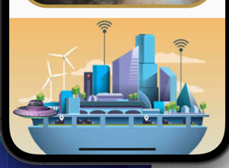
Combining 2 animated widget
In this example we will resize the ufo.gif, being bigger and smaller, so it seems like go flying to the city and back again.
Change the Image with AnimatedContainer. We need to manage a variable for resizing the container. Put in the timer, a bigger number when container in the top, and smaller when in bottom.
AnimatedContainer(
duration: const Duration(seconds: 3),
width: _wh,
height: _wh,
child: Image.asset("../assets/images/ufo.gif"),
)

Slide 24
Solution
double _wh = 40;
--------------
if (_posisi == 1) {
_left = 300;
_top = 0;
_wh = 40;
}
if (_posisi == 2) {
_left = 0;
_top = 0;
_wh = 40;
}
if (_posisi == 3) {
_left = 0;
_top = 140;
_wh = 160;
}
if (_posisi == 4) {
_left = 300;
_top = 140;
_wh = 160;
}
AnimatedPositioned(
duration: const Duration(seconds: 3),
curve: Curves.fastOutSlowIn,
left: _left,
top: _top,
child: AnimatedContainer(
duration: const Duration(seconds: 3),
width: _wh,
height: _wh,
child: Image.asset("../assets/images/ufo.gif"),
),
),

Slide 25
TWEEN ANIMATION BUILDER
09

Slide 26
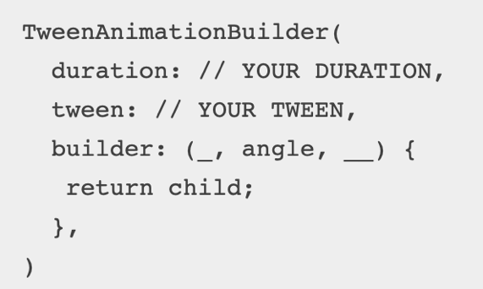
TweenAnimation
In simple words, now you can create your own Custom Implicit Animations with Tween Animation Builder…
Tween Animation Builder is A widget builder that animates the property of a Widget to a target value.
Use TweenAnimation when :
There is no animationfoo can handle
Not need a setState. Can be used in a stateless widget

Slide 27
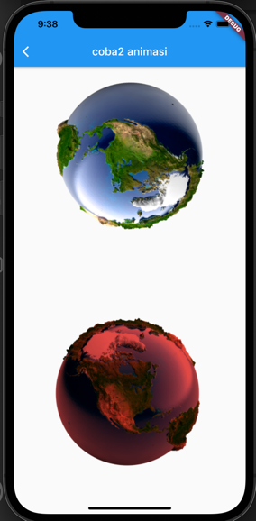
Rotate and changing color
TweenAnimationBuilder(
duration: const Duration(seconds: 20),
tween: Tween<double>(begin: 0, end: 5 * math.pi),
builder: (_, double angle, __) {
return Transform.rotate(
angle: angle,
child: Image.asset('../assets/images/earth.png'),
);
},
),
Add import 'dart:math' as math;
TweenAnimationBuilder(
child: Image.asset('../assets/images/earth.png'),
duration: const Duration(seconds: 10),
tween: ColorTween(begin: Colors.blue, end: Colors.red),
builder: (_, Color? color, Widget? child) {
return ColorFiltered(
colorFilter: ColorFilter.mode(color!, BlendMode.modulate),
child: child,
);
},
),
This is called “bang” operator

Slide 28
Bang operator (!)
In Dart language, the bang operator (!) is also known as the null assertion operator. It is used to indicate that a value is guaranteed not to be null, even if its type is nullable.
By adding “!” after a variable, we force Dart to treat that value as non-nullable. However, if the value actually turns out to be null when running, a runtime error will occur (“Null check operator used on a null value”).
Therefore, the bang operator should only be used when you are absolutely sure that the value has been initialized or can never be null.

Slide 29
Assignment
Upload your class progress(from Week 1 until Week 7) to ULS. Submit only the lib folder, compressed into a .zip file. Make sure to submit it before the deadline.
Deadline: Saturday, October 18, 2025, at 23.59

Slide 30



